Slide 1
DND Live Image Generator
Digcre
Cyrill Tschopp / Alex Wyss

Slide 2
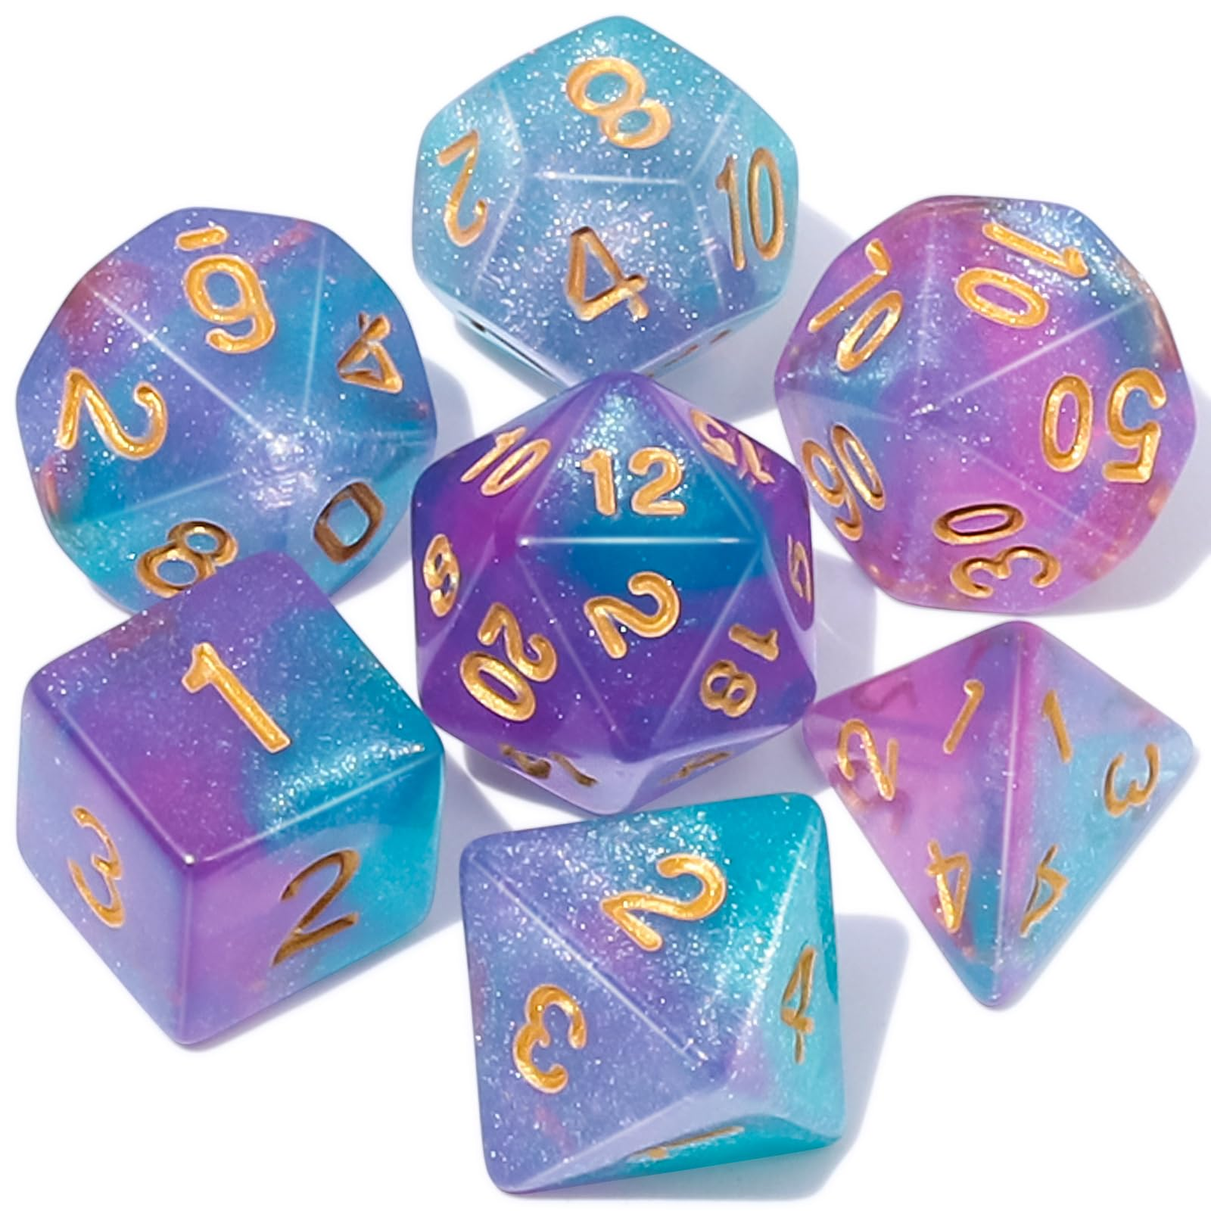
Base Idea
DND Session Recording
Speech to text
Promting using LLM
Image Generation using live Prompt
Displaying Image as soon as Available

Slide 3
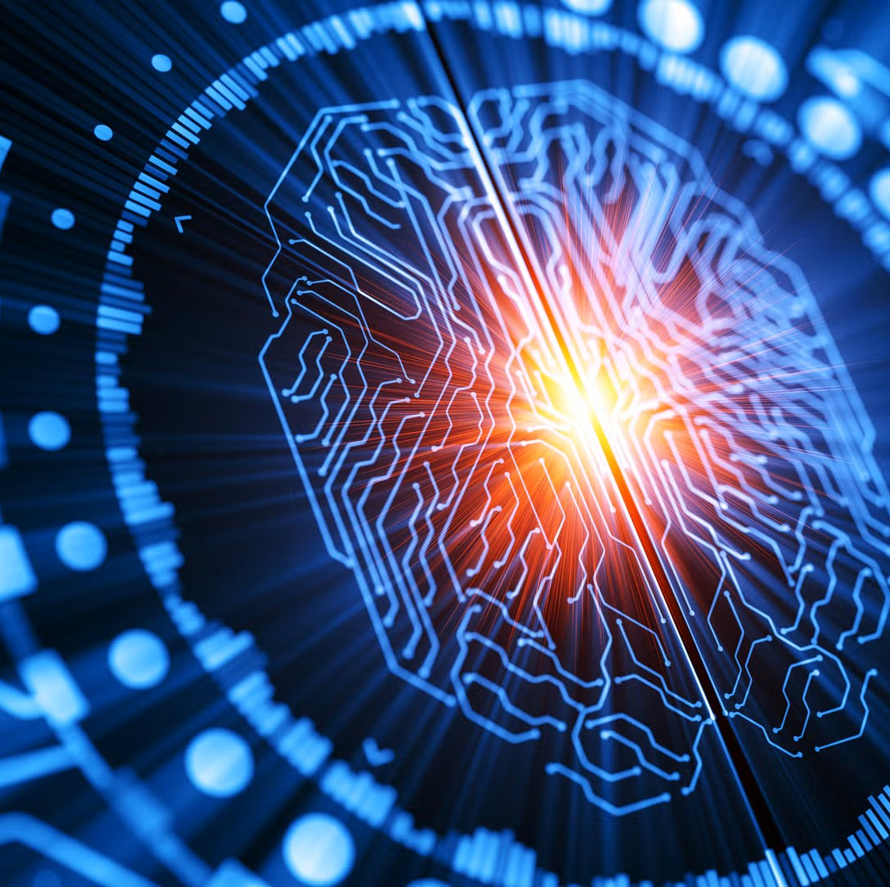
Technologies
Python
Discord / Discord Bot
Replicate
Whisper
Llama ?
Picture Model?

Slide 4
Problems & Solutions
Problems
Solutions
Continuous Recording
Good Prompts
Who Spoke?
Time Delays
Cut up Conversation
Using LLM to create Prompt
Discord speaker Identification
Slow Game → No Time pressure

Slide 5

Current State
Discord Bot
Recording
Speech To Text
Whats Next
Cut up Recording
Improving Speech to text
Implement LLM
Feed LLM Promt to Picture Model
Display Pictures

